Slide 1
Exam 3 Review

Slide 2
Equations for dot and cross product

Slide 3
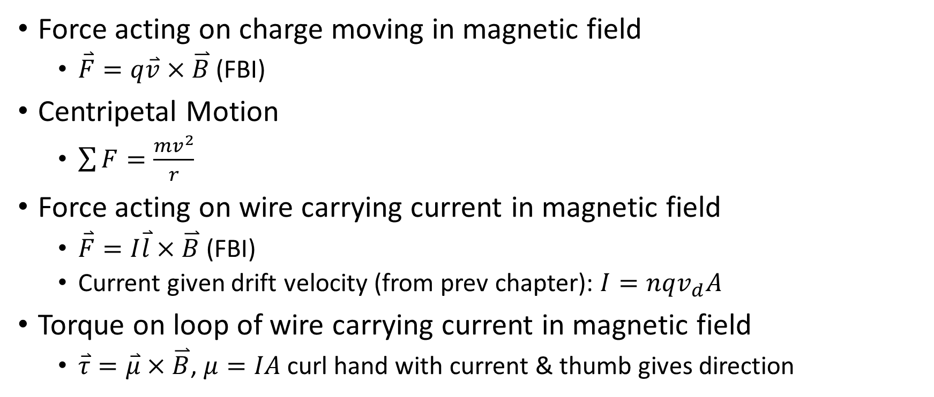
Ch 27 Forces on Moving Charges and Currents in Magnetic Fields
Force acting on charge moving in magnetic field
$\overset{⃑}{F}=q\overset{⃑}{v}×\overset{⃑}{B}$ (FBI)
Centripetal Motion
$\sum{F=\frac{mv^{2}}{r}}$
Force acting on wire carrying current in magnetic field
$\overset{⃑}{F}=I\overset{⃑}{l}×\overset{⃑}{B}$ (FBI)
Current given drift velocity (from prev chapter): $I=nqv_{d}A$
Torque on loop of wire carrying current in magnetic field
$\overset{⃑}{τ}=\overset{⃑}{μ}×\overset{⃑}{B}$, $μ=IA$ curl hand with current & thumb gives direction

Slide 4
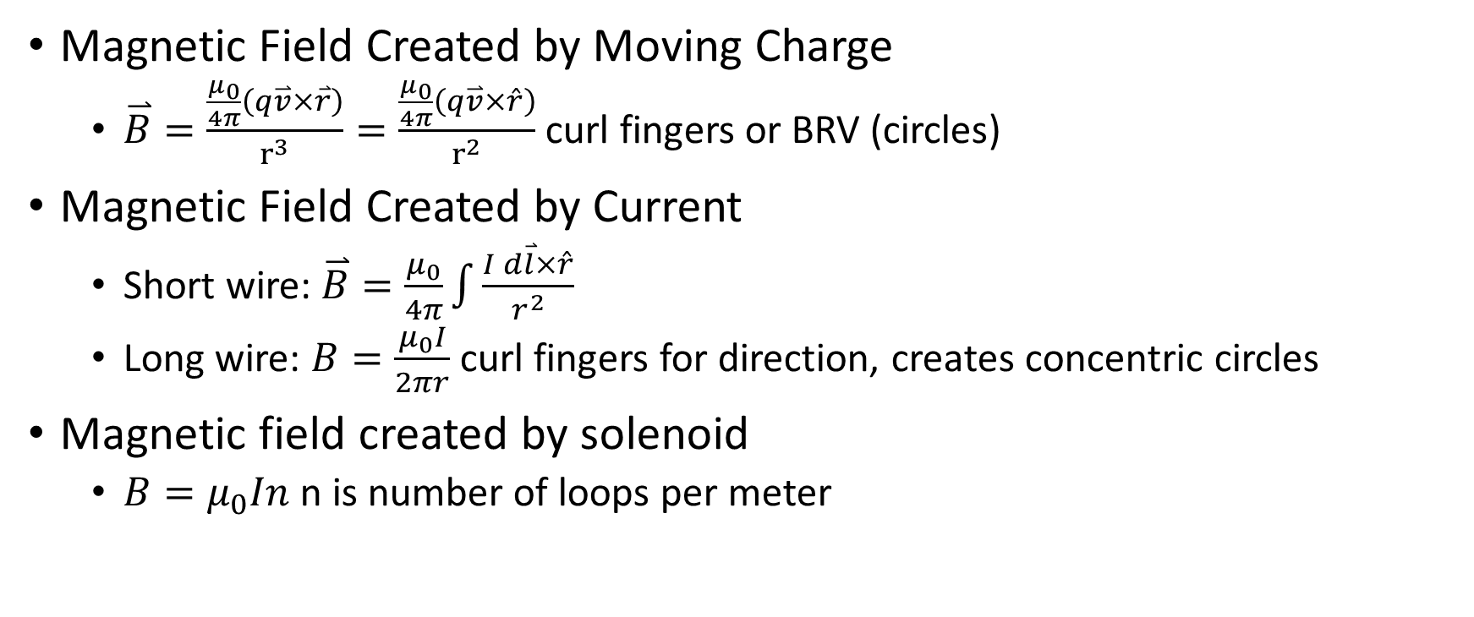
Ch 28 Magnetic Fields Created by Moving Charges and Currents
Magnetic Field Created by Moving Charge
$\overset{⃑}{B}=\frac{\frac{μ_{0}}{4π}\left(q\overset{⃑}{v}×\overset{⃑}{r}\right)}{r^{3}}=\frac{\frac{μ_{0}}{4π}\left(q\overset{⃑}{v}×\hat{r}\right)}{r^{2}}$ curl fingers or BRV (circles)
Magnetic Field Created by Current
Short wire: $\overset{⃑}{B}=\frac{μ_{0}}{4π}\int{\frac{I d\overset{⃑}{l}×\hat{r}}{r^{2}}}$
Long wire: $B=\frac{μ_{0}I}{2πr}$ curl fingers for direction, creates concentric circles
Magnetic field created by solenoid
$B=μ_{0}In$ n is number of loops per meter

Slide 5
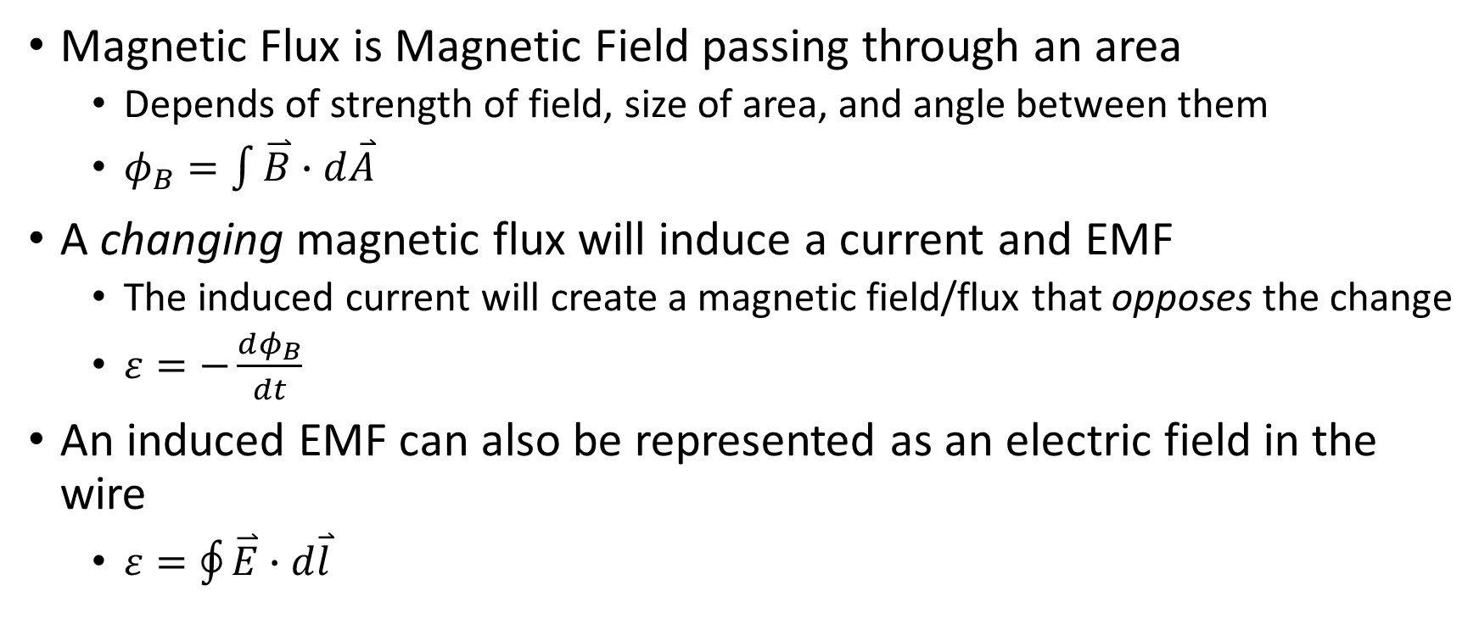
Ch 29 Magnetic Flux and Induced EMF
Magnetic Flux is Magnetic Field passing through an area
Depends of strength of field, size of area, and angle between them
$φ_{B}=\int{\overset{⃑}{B}∙d\overset{⃑}{A}}$
A changing magnetic flux will induce a current and EMF
The induced current will create a magnetic field/flux that opposes the change
$ε=−\frac{dφ_{B}}{dt}$
An induced EMF can also be represented as an electric field in the wire
$ε=\oint{\overset{⃑}{E}∙d\overset{⃑}{l}}$

